Slide 1
Component Interactions
Component hierarchies
Component inputs
Component outputs
Demo app: AngularDev/Demos/05-ComponentInteractions/DemoApp
To install: npm install
To run: ng serve

Slide 2
Section 1: Component Hierarchies
Overview
Component hierarchy example
Component code organization
Low-level components
High-level component
Bundling components

Slide 3
Overview
An Angular application typically has many components
Each component renders a portion of UI real estate
If a component is starting to get too complex…
You can split it into lower-level components
Just like you split complex functions into smaller ones
This creates a more modular application:
Components are simpler, easier to test, possibly reusable
3

Slide 4
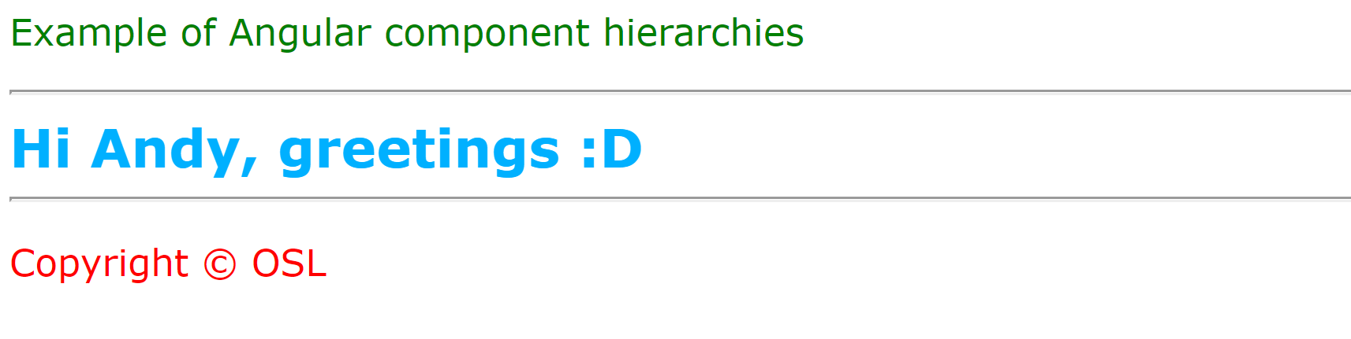
Component Hierarchy Example
Let's see an example of a component hierarchy
In the demo app, click the Component hierarchy link
GreetingComponent
HeaderComponent
FooterComponent
4

Slide 5
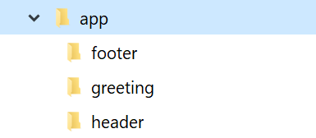
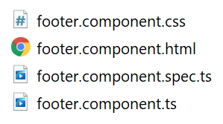
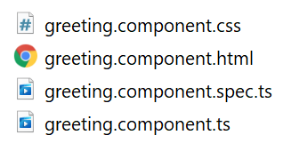
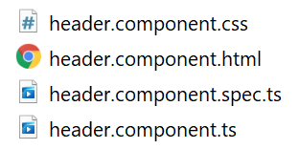
Component Code Organization
It's common to put each component into a separate folder in your application
A folder contains all the code files for a component
5

Slide 6
Low-Level Components
Here are the header and footer components
Also see the HTML and CSS files for each component
@Component({
selector: 'app-header',
templateUrl: './header.component.html',
styleUrls: ['./header.component.css']
})
export class HeaderComponent {}
header.component.ts
@Component({
selector: 'app-footer',
templateUrl: './footer.component.html',
styleUrls: ['./footer.component.css']
})
export class FooterComponent {}
footer.component.ts
6

Slide 7
High-Level Component (1 of 2)
Here's the high-level greeting component code:
@Component({
selector: 'app-greeting',
templateUrl: './greeting.component.html',
styleUrls: ['./greeting.component.css']
})
export class GreetingComponent {
name = 'Andy'
}
greeting.component.ts
7

Slide 8
High-Level Component (2 of 2)
Here's the high-level greeting component HTML:
Note:
<app-header> tag instantiates HeaderComponent
<app-footer> tag instantiates FooterComponent
<app-header></app-header>
<div class="greetingContent">
Hi {{name}}, greetings :D
</div>
<app-footer></app-footer>
greeting.component.html
8

Slide 9
Bundling Components
Remember to bundle your components into a module
In a small app, put all components in the root module
In a large app, you can define multiple feature modules
import { GreetingComponent } from './greeting/greeting.component';
import { HeaderComponent } from './header/header.component';
import { FooterComponent } from './footer/footer.component';
…
@NgModule({
declarations: [GreetingComponent, HeaderComponent, FooterComponent, … ],
…
})
export class AppModule { }
app.module.ts
9

Slide 10
Section 2: Component Inputs
Overview
Component inputs example
Specifying an input property
Setting an input property

Slide 11
Overview
Imagine you have a hierarchy of components…
A high-level component gets data from somewhere
The high-level component wants to pass the data into a lower-level component, to be displayed etc.
Angular allows a high-level component to pass a value into a low-level component property
In low-level component, decorate property with @Input
In high-level component, assign a value to property
11

Slide 12
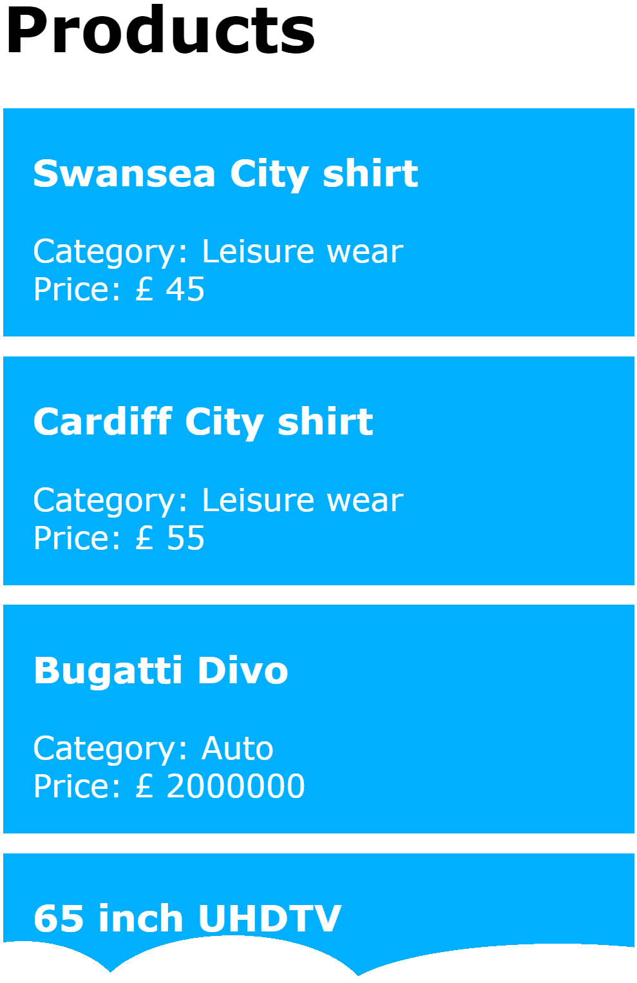
Component Inputs Example
Let's see an example of component inputs
In the demo app, click the Component inputs link
ProductListComponent
ProductItemComponent
12

Slide 13
Specifying an Input Property
To specify that a component's property will be input from another component:
Decorate the property with @Input()
import { Component, Input } from '@angular/core';
import { Product } from '../product'
@Component({
selector: 'app-product-item',
templateUrl: './product-item.component.html',
styleUrls: ['./product-item.component.css']
})
export class ProductItemComponent {
@Input()
product!: Product;
}
product-item.component.ts
13

Slide 14
Setting an Input Property
To set the value for a component's input property:
Use [] to specify the property name
Supply a suitable input value
<h1>Products</h1>
<div>
<div *ngFor="let p of products">
<app-product-item [product]="p"></app-product-item>
</div>
</div>
product-list.component.html
14

Slide 15
Summary
Component hierarchies
Component inputs

Slide 16
Annex: Component Outputs
Overview
Component outputs example
Defining an event interface
Emitting events
Aside: Lifecycle hooks
Handling events

Slide 17
Overview
Imagine you have a hierarchy of components…
A low-level component modifies data and wants to notify any "interested listeners" about these changes
A high-level component is an interested listener, i.e. it wants to know about these changes
Angular allows components to emit events
In low-level component, emit event when data changes
In high-level component, define event-handler for event
17

Slide 18
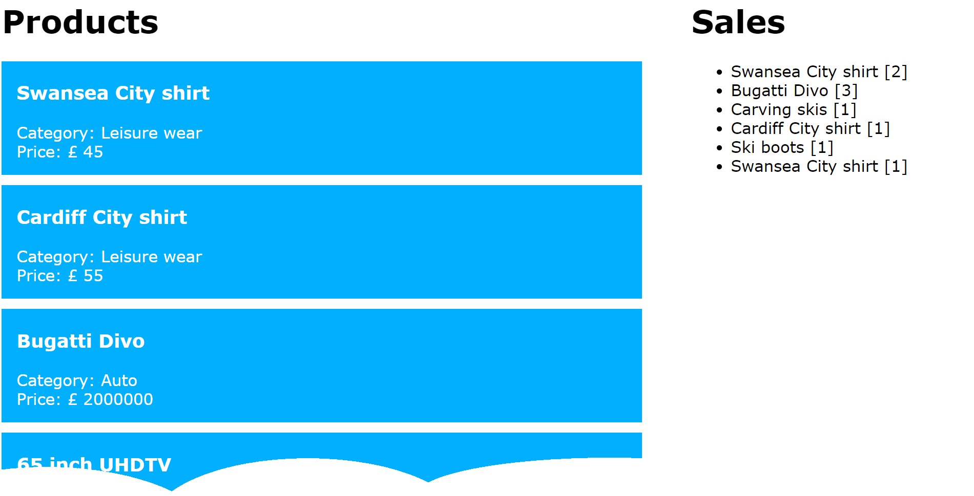
Component Outputs Example
Let's see an example of component outputs
In the demo app, click the Component outputs link
ProductListWithSalesComponent
ProductItemWithSalesComponent
(emit "sale" events periodically)
18

Slide 19
Defining an Event Interface
The first step is to define an event interface
Specifies info the low-level component wants to pass up to the high-level component
E.g. ProductItemWithSalesComponent emits a "sale" event periodically
We represent the "sale" event via the ISale interface
export interface ISale {
productDescription: string;
quantity: number;
};
product-item-with-sales.component.ts
19

Slide 20
Emitting Events
To emit an event from a component:
Define EventEmitter property as an @Output()
Call emit() to emit an event, and pass event data
@Component(…)
export class ProductItemWithSalesComponent implements OnInit {
@Input()
product!: Product;
@Output()
sale: EventEmitter<ISale> = new EventEmitter();
ngOnInit() {
setInterval(() => {
let eventData: ISale = {…}
this.sale.emit(eventData);
}, 1000 + (5000 * Math.random()));
}
}
product-item-with-sales.component.ts
20

Slide 21
Aside: Lifecycle Hooks
ProductItemWithSalesComponent implements the OnInit interface
This is an Angular lifecycle hook
Angular calls the component's ngOnInit() method
After object has been constructed and inputs applied
import {OnInit, … } from '@angular/core';
@Component(…)
export class ProductItemWithSalesComponent implements OnInit {
ngOnInit() { /* Do any initialization that uses @Input() properties */ }
}
21

Slide 22
Handling Events
To handle events from low-level component property:
Use () to specify property name that might emit events
Define a suitable event handler function
<div *ngFor="let p of products">
<app-product-item-with-sales [product]="p" (sale)="onSale($event)">
</app-product-item-with-sales>
</div>
product-list-with-sales.component.html
@Component(…)
export class ProductListWithSalesComponent {
products: Array<Product> = [];
sales: Array<string> = [];
…
onSale(event: ISale) {
let msg:string = event.productDescription + ' [' + event.quantity + ']';
this.sales.push(msg);
}
}
product-list-with-sales.component.ts
22

